Slide 1

Rozwiązanie problemu komiwojażera algorytmem łączącym symulowane wyżarzanie z parallel tempering
Łukasz Grabarski, Magdalena Jeczeń, Karolina Mączka, Mateusz Nizwantowski, Marta Szuwarska

Slide 2
Plan prezentacji
Algorytm
Modyfikacje algorytmu
Parametry
Testowanie parametrów
Ostateczne wyniki

Slide 3
Algorytm

Slide 4
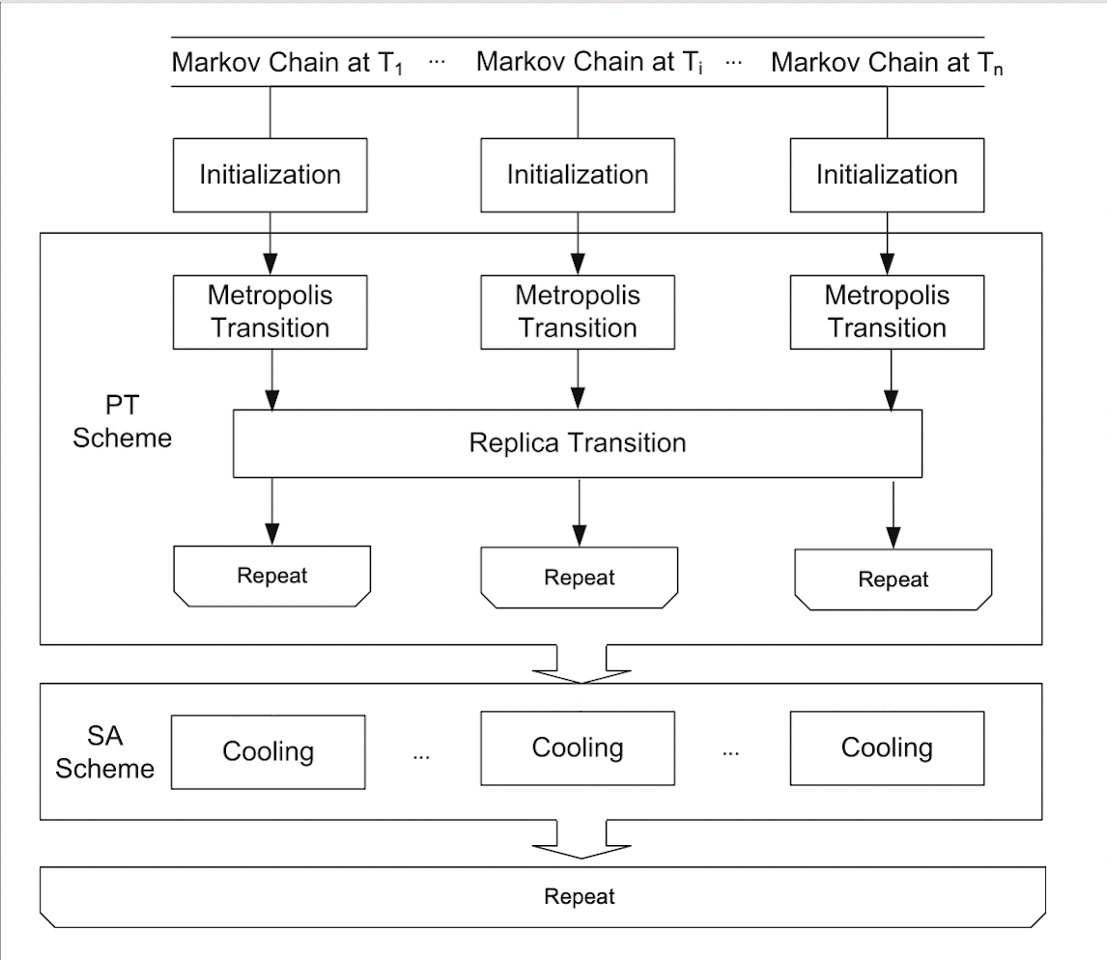
General idea

Slide 5
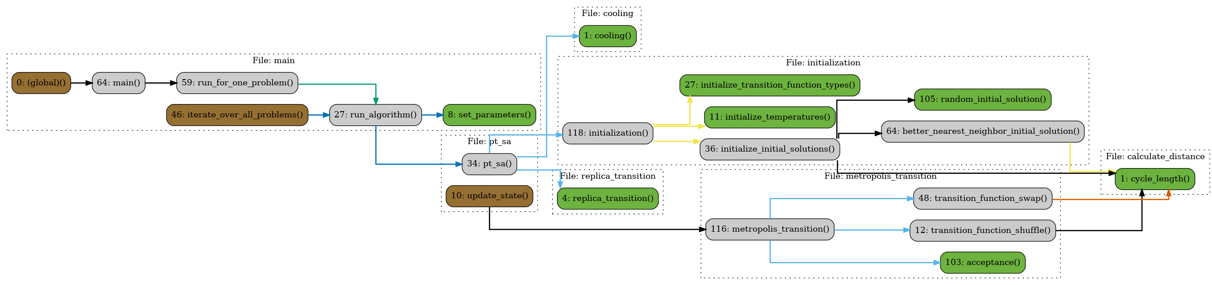
Nasza Implementacja

Slide 6
Modyfikacje

Slide 7
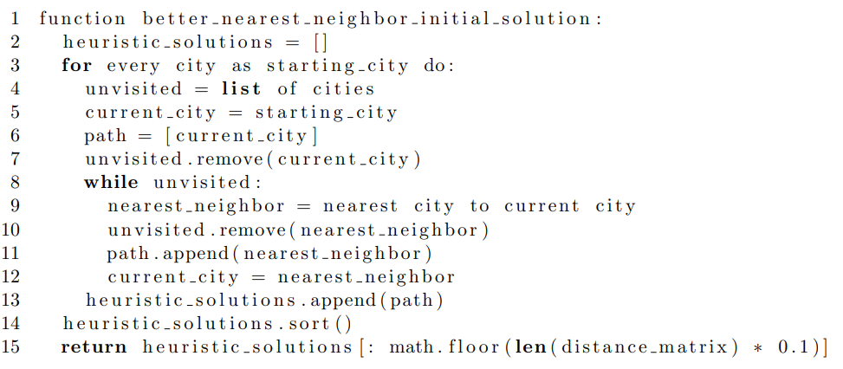
Zaczynanie od rozwiązań heurystycznych
Notes:
While initializing initial solutions, some of the solutions we create randomly and the rest using the nearest neighbour algorithm. In the nearest neighbour algorithm, we start from a city we will call 'starting city'. Then we go to the city with the least distance from our starting city. Analogically, we find the next nearest city. We repeat the process until all cities are visited. In the function better\_nearest\_neighbor\_initial\_solution(), we perform the nearest neighbour algorithm for every city as starting city. Then we sort them by solution length and save the best 10\% of solutions.

Slide 8
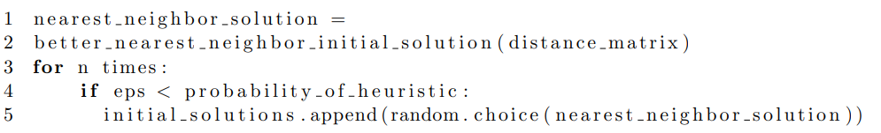
Zaczynanie od rozwiązań heurystycznych
Notes:
Whereas initializing a suboptimal solution, we take a random solution from those saved heuristic solutions.

Slide 9
Jak dużo dały rozwiązania heurystyczne?
Problem | PTSA | Małpki | N | Heurystyka
FTV38 | 1608 | 1779 | 1652 | 1759
FT70 | 40218 | 46864 | 40286 | 41815
RBG403 | 2957 | 4371 | 7019 | 3497
Dla wszystkich 17 problemów nasze rozwiązanie heurystyczne liczy się w 5.6 sekundy, produkując na ogół rozwiązania gorsze o 22.4% od optymalnego.

Slide 10
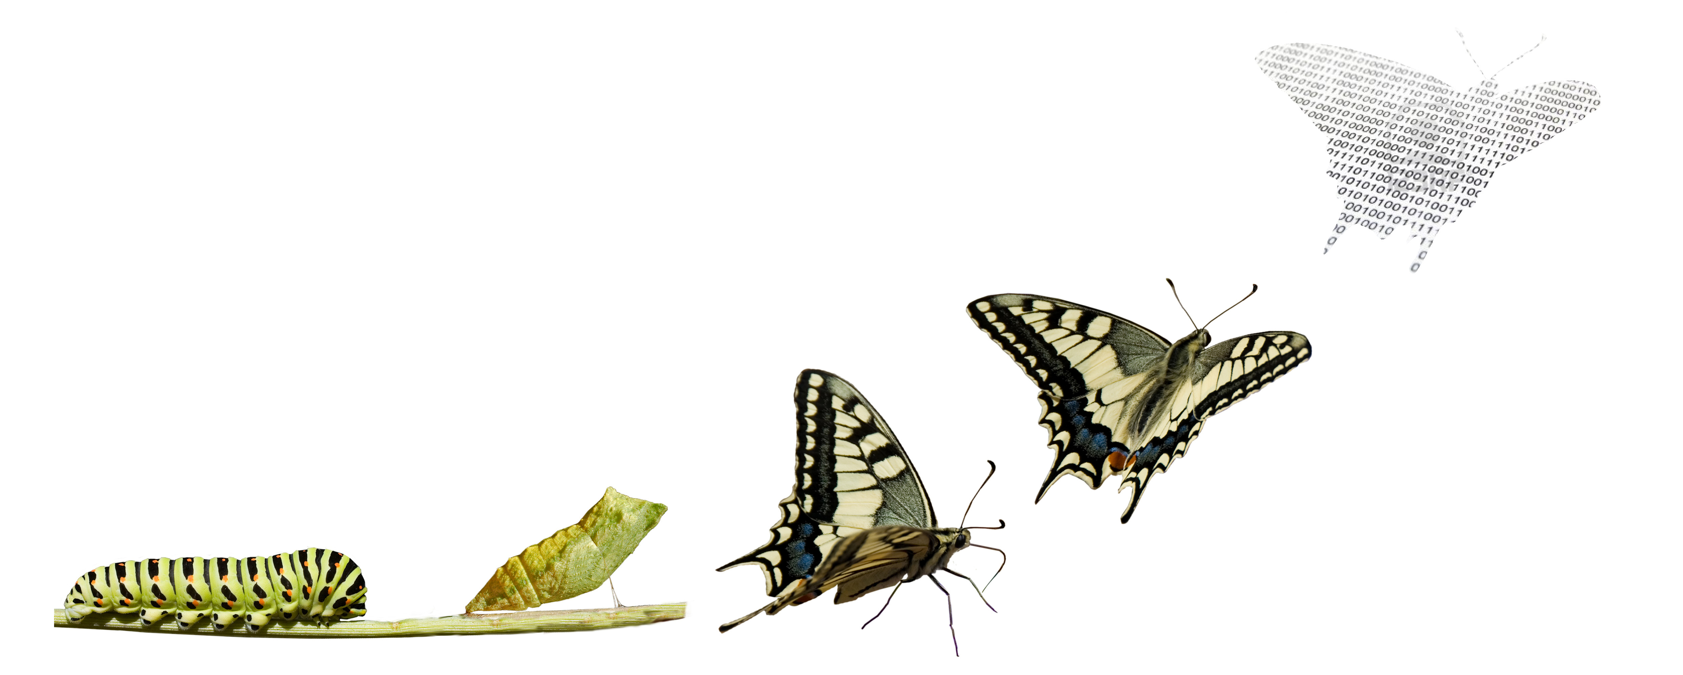
Implementacja dwóch typów metropolis transition
Obrazek 1, [1]
Notes:
For metropolis transition, we have implemented two different approaches: shuffle transition and swap transition. Each state is assigned only one of them. Both of those functions also have a given transformation length, which states the length of the path in the solution that will be changed.

Slide 11
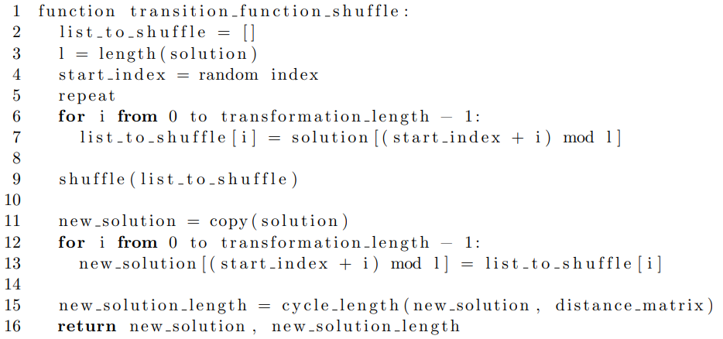
Shuffle transition
Notes:
In the shuffle transition, from a given solution we randomly choose a path of transformation length. We do it by randomly choosing the starting index first and then going to the next cities from the solution until we have a path of the given length. Since the solutions are cycles, if we get to the 'end' of the solution, we wrap to the first city.
For example, if we have a solution [1, 2, 3, 4, 5, 6, 7, 8, 9, 10] with a transformation length equal to 3 and randomly chosen starting index 9, then we end up with a path [9, 10, 1].Having chosen a path, we shuffle it and replace the old path in the solution with the new path. In our example, if our new path after shuffling were [1, 10, 9], then our new solution would be [9, 2, 3, 4, 5, 6, 7, 8, 1, 10].

Slide 12
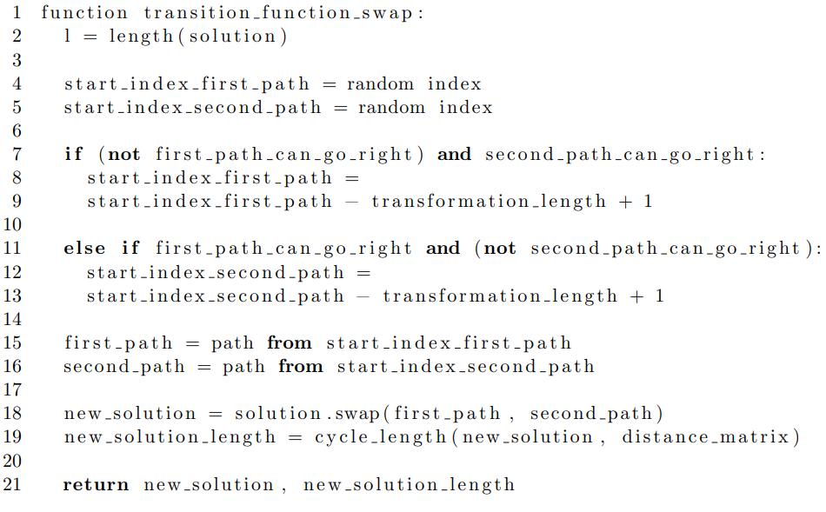
Swap transition
Notes:
In the swap transition, from a given sequence we randomly choose two non-overlapping paths of transformation length. We do it by randomly choosing two starting indices first and then going to the next or previous cities from the solution until we have a path of the given length.
By default, we take the next cities, however, if it is not possible, we take the previous cities. Firstly, we check if there are enough cities between the first index and the second index to make a path of transformation length going right from the first index. Secondly, we check if there are enough cities between the second index and the first index on the cycle to make a path of transformation length going right from the second index. If the first condition is not satisfied but the second is, we take the cities before the city with the first index and end up with the first path ending with the city with the first index. Otherwise, if the first condition is satisfied but the second is not, we take the cities before the city with the second index and end up with the second path ending with the city with the second index.
For example, we are given a solution [1, 2, 3, 4, 5, 6, 7, 8, 9, 10] with a transformation length equal to 3. If we draw starting cities 2 and 6, we end up with paths [2, 3, 4] and [6, 7, 8]. If we draw starting cities 5 and 6, we end up with paths [3, 4, 5] and [6, 7, 8]. If we draw starting cities 1 and 10, we end up with paths [1, 2, 3] and [8, 9, 10].Having chosen two paths, we swap them in the given solution. In this way, in the first case, we get the new solution [1, 6, 7, 8, 5, 2, 3, 4, 9, 10]. In the second case, we get [1, 2, 6, 7, 8, 3, 4, 5, 9, 10]. Finally, in the third case, we get [8, 9, 10, 4, 5, 6, 7, 1, 2, 3].

Slide 13
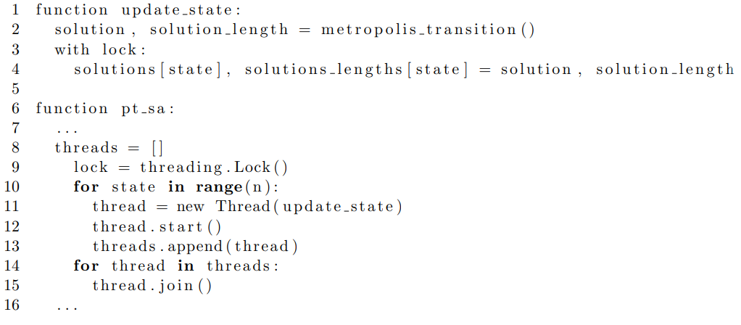
Przyśpieszenie metropolis transition za pomocą wielowątkowości
Notes:
Metropolis transition is applied to every state separately. This way, updating states are independent of each other. Therefore, applying multithreading here becomes quite an obvious way to speed up the process.
We moved updating states, i.e. applying metropolis transition, to a new function, in which we update them and save them to a shared list of solutions with lock to prevent from reading not saved data. We start threads and join them in the pt\_sa() function.

Slide 14
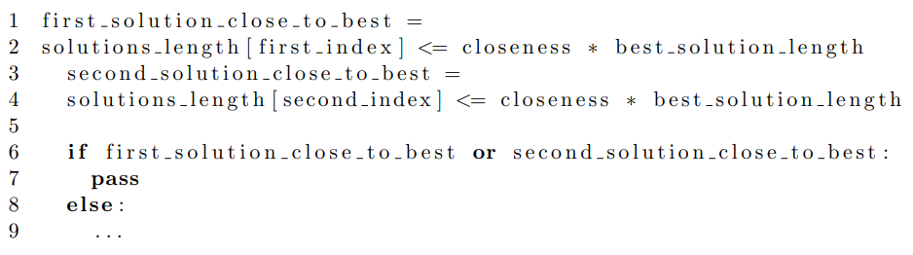
Pominięcie rozwiązań bliskich najlepszemu rozwiązaniu w replica transition
Notes:
In replica transition, when we come across a solution close to the current best solution, we do not want to change it too much since we are already on the right track. Therefore, if one of the solutions in the states chosen for swapping is close to the best solution, we skip swapping there.

Slide 15

Wielokrotne uruchamianie algorytmu w ciągu 5 minut
Obrazek 2, [2]
Notes:
While testing our algorithm with different durations of execution, we noticed that longer duration does not necessary mean better solutions. Therefore, we set out to test whether it would be better in some cases to run the algorithm from the very beginning a few short times rather than one long time.
In order to do that, we ran the algorithm for every problem and saved the best found solutions after 0.25, 0.5, 1, 1.5, 2, 2.5 and 3 minutes. We also compared our solutions with the best known solutions and saved how much time was needed to get a solution worse by 1\%, 2\%, 3\%, 5\%, 10\%, 15\%, 20\%, 30\% and 50\% than best known solutions. However, if the time exceeded 186 second, we skipped it. If we want to divide our entire time of execution (5 minutes), then we need to divide it to at lest two iterations (2.5 minutes each). Hence, if the best solution still changes after 2.5 minutes, we should run the algorithm only once for the entire time (5 minutes). We considered 186 seconds to be enough over 2.5 minutes to ensure checking that. We saved all that information into a dataframe.

Slide 16
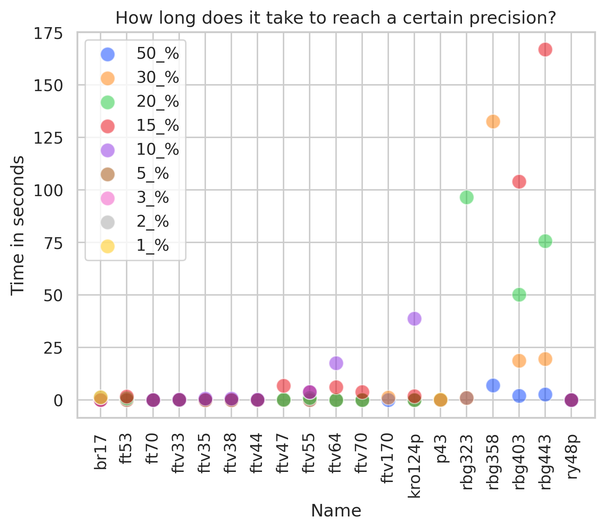
Porównanie czasu potrzebnego do osiągnięcia danej precyzji
Notes:
In order to compare the results of our test, we made some plots. In the first one, we compared for every problem how much time in seconds was needed to reach certain precision, meaning solution worse by certain percentage than best known solution for the given problem. As we can see, for the problem rbg403, after only a few seconds, the precision of the solution is about 50\%. However, after about 20 seconds, it becomes about 30\%, after about 50 seconds, it becomes about 20\%, and after about 100 second, it becomes 15\%. For the problems kro124p, rbg323 and rbg443, the precision also improves with time. Nevertheless, in other cases the solutions stop improving after 30 seconds.

Slide 17
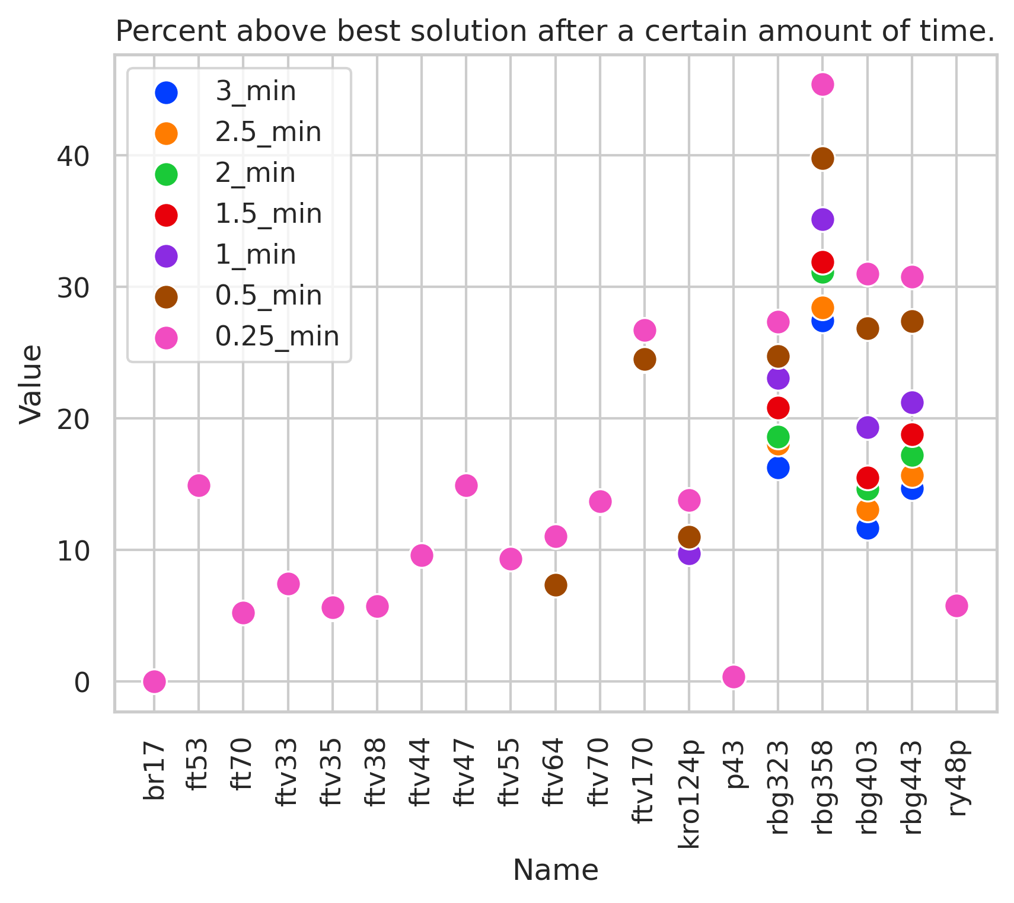
Porównanie precyzji osiągniętej po danej ilości czasu
Notes:
In the second plot, we compared for every problem what precision was reached after certain amounts of time. As shown, in most cases the best precision was reached after 0.25 minutes. Regardless, in some cases the precision increases after a longer time. For the problems rbg323, rbg358, rbg403 and rbg443, the best precisions were reached after 3 minutes. Additionally, in the case of the problem kro124p, the best precision was reached after 1 minute, and in the case of the problems ftv64 and ftv170, the best precision was reached after 0.5 minutes.

Slide 18
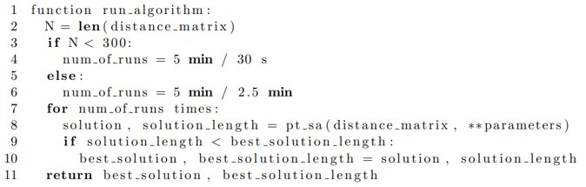
Wielokrotne uruchamianie algorytmu w ciągu 5 minut
Notes:
We noticed a trend that the problems with dimensions above 300 usually need more time to get to the best precision, therefore we decided to run the algorithm 2 times for 2.5 minutes for the problems with dimensions above 300 and 10 times for 30 second for the rest of the problems.

Slide 19
Parametry

Slide 20
Lista parametrów jakich używamy:
n - liczba stanów
min_temperature - minimalna temperatura,
max_temperature - maksymalna temperatura,
probability_of_shuffle - prawdopodobienstwo użycia shuffle transition
probability_of_heuristic - prawdopodobienstwo użycia rozwiązania heurystycznego
a - pierwszy parametr rozkładu beta
b - drugi parametr rozkładu beta
Notes:
In the second plot, we compared for every problem what precision was reached after certain amounts of time. As shown, in most cases the best precision was reached after 0.25 minutes. Regardless, in some cases the precision increases after a longer time. For the problems rbg323, rbg358, rbg403 and rbg443, the best precisions were reached after 3 minutes. Additionally, in the case of the problem kro124p, the best precision was reached after 1 minute, and in the case of the problems ftv64 and ftv170, the best precision was reached after 0.5 minutes.

Slide 21
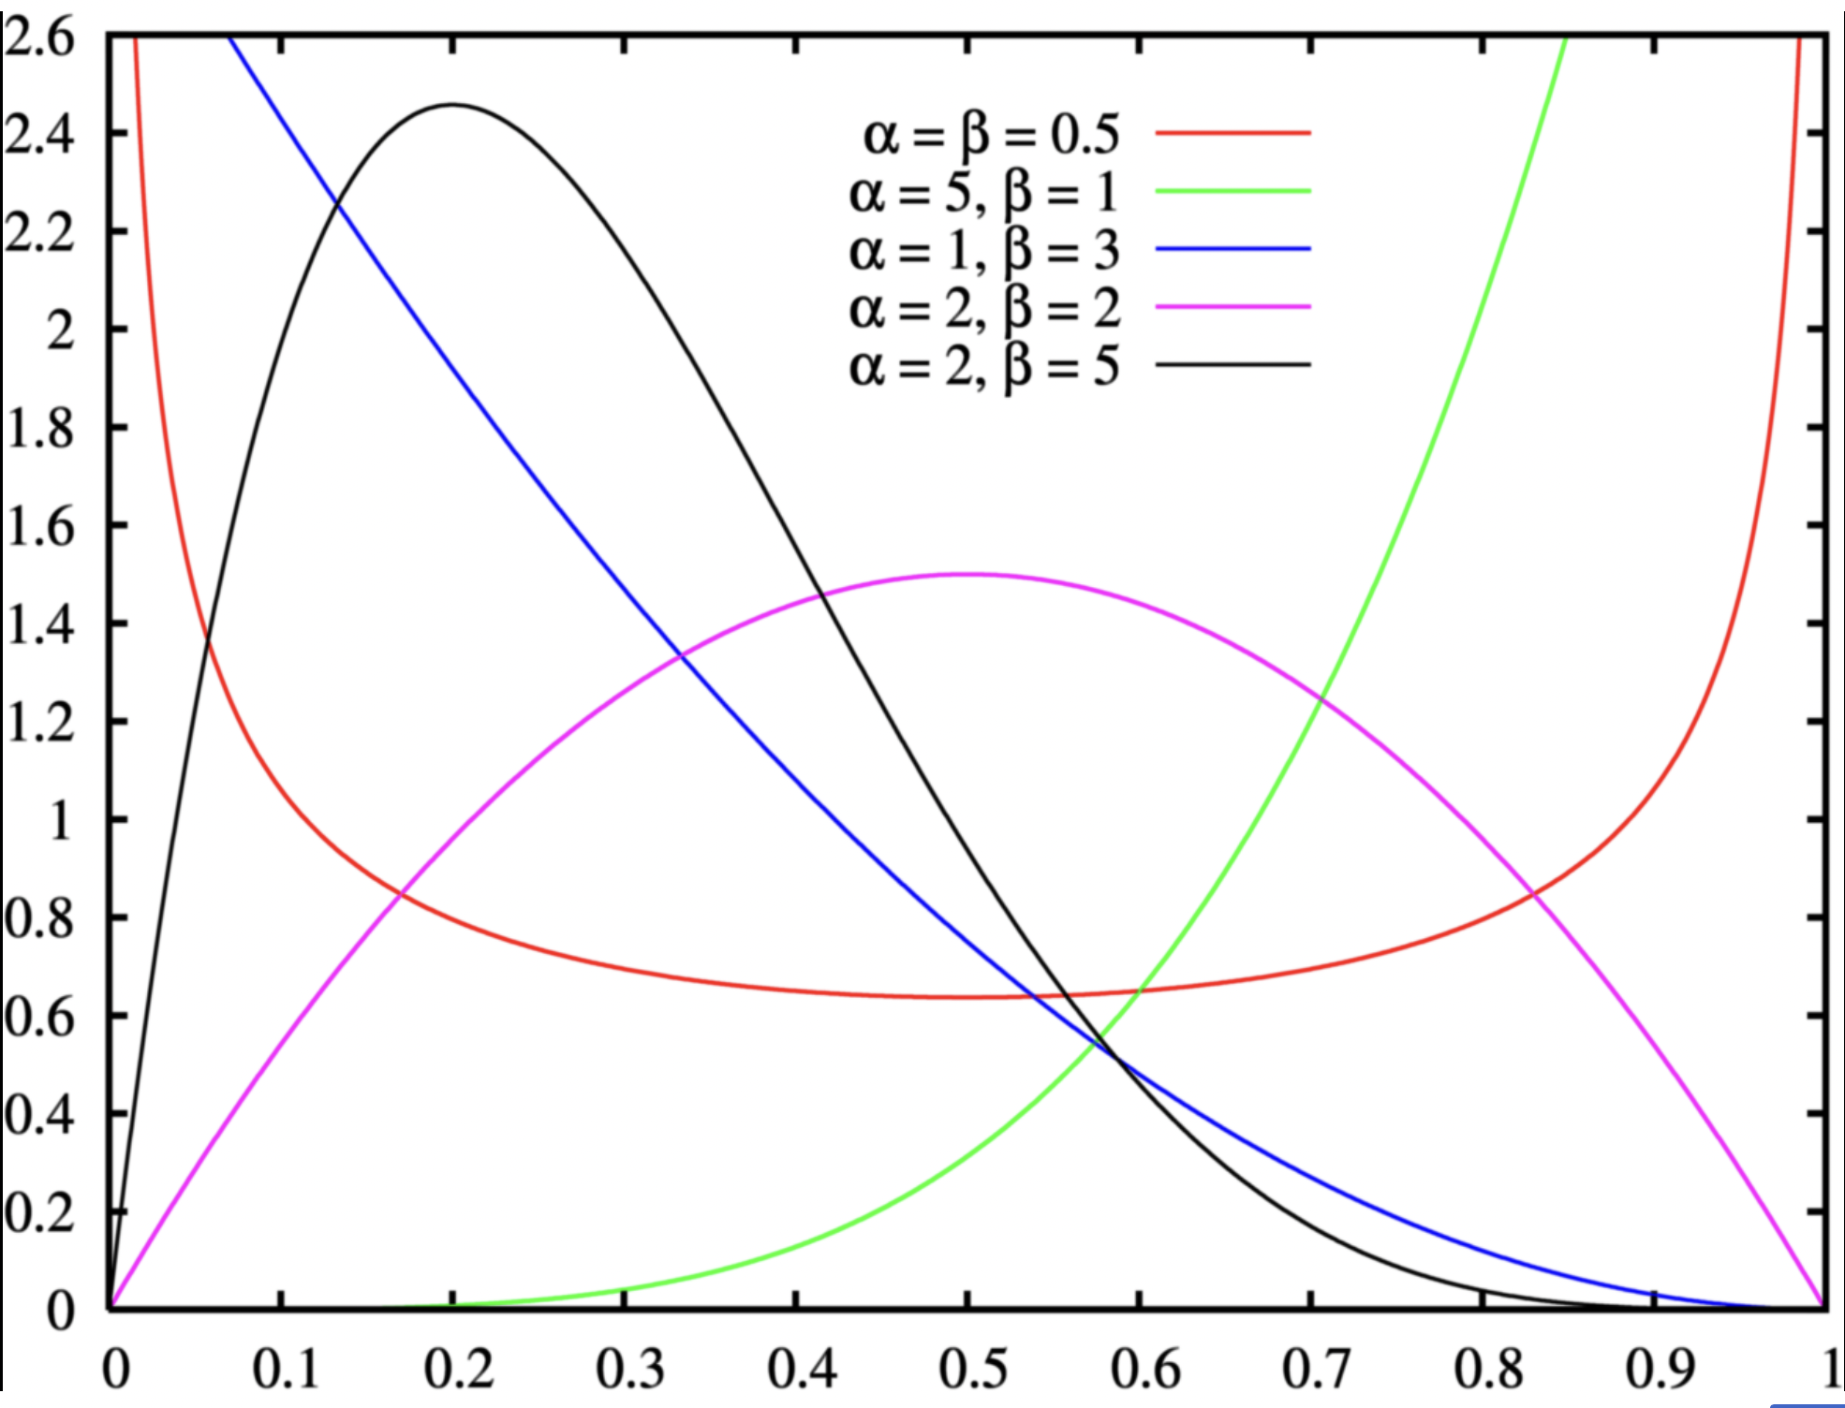
Rozkład beta dla różnych parametrów

Slide 22
duration_of_execution_in_seconds - czas, przez jaki algorytm działa,
k - liczba wykonań fazy PT zanim przystąpimy do fazy SA,
max_length_percent_of_cycle - jak długie ścieżki zmieniamy w metropolis transitions,
swap_states_probability - prawdopodobieństwo zamiany temperatur pomiędzy stanami,
closeness - jak blisko trzeba być od najlepszego rozwiązania, żeby nie zmieniać temperatury w replica tranistion,
cooling_rate - szybkość chłodzenia.
Notes:
In the second plot, we compared for every problem what precision was reached after certain amounts of time. As shown, in most cases the best precision was reached after 0.25 minutes. Regardless, in some cases the precision increases after a longer time. For the problems rbg323, rbg358, rbg403 and rbg443, the best precisions were reached after 3 minutes. Additionally, in the case of the problem kro124p, the best precision was reached after 1 minute, and in the case of the problems ftv64 and ftv170, the best precision was reached after 0.5 minutes.

Slide 23
Testowanie parametrów

Slide 24
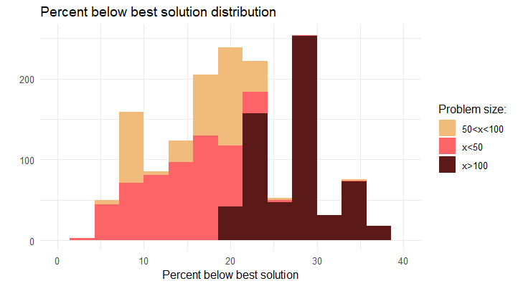

Slide 25
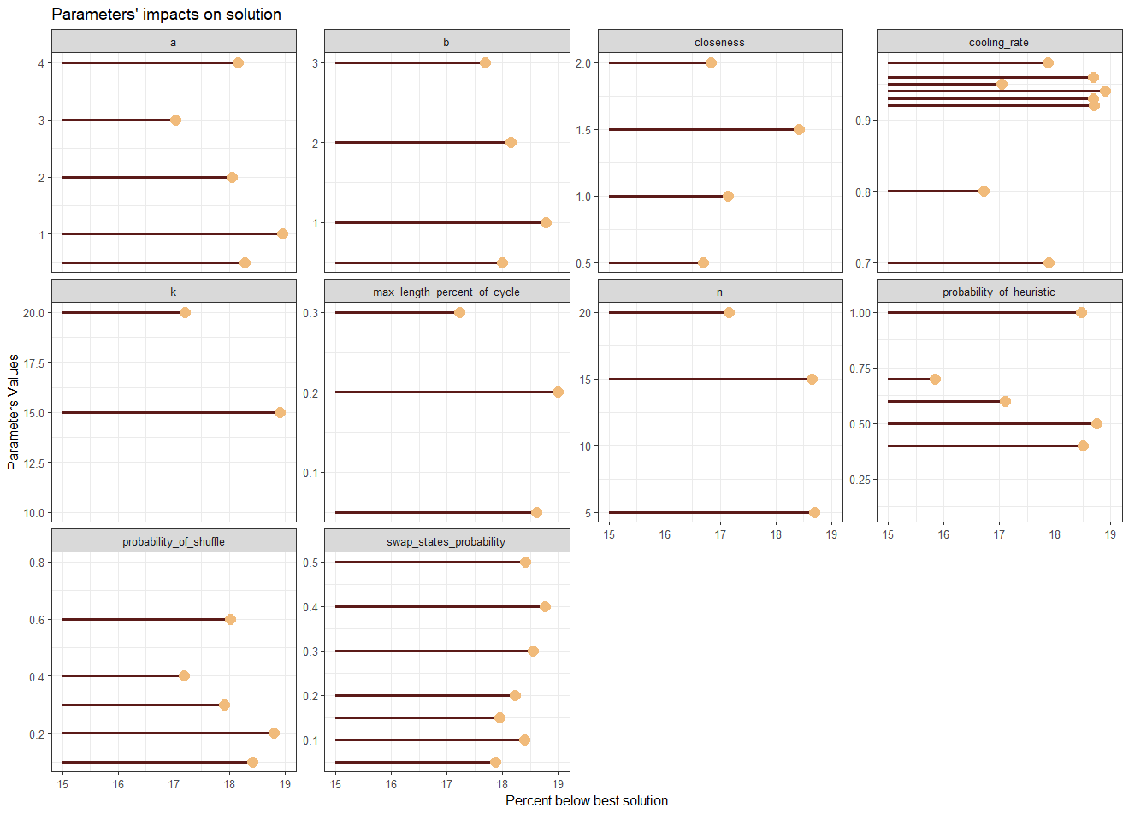

Slide 26
Ostateczne wyniki

Slide 27

Najlepszy wynik zależnie od czasu przeprowadzania algorytmu (dla czasu całkowitego wynoszącego 5min)

Slide 28
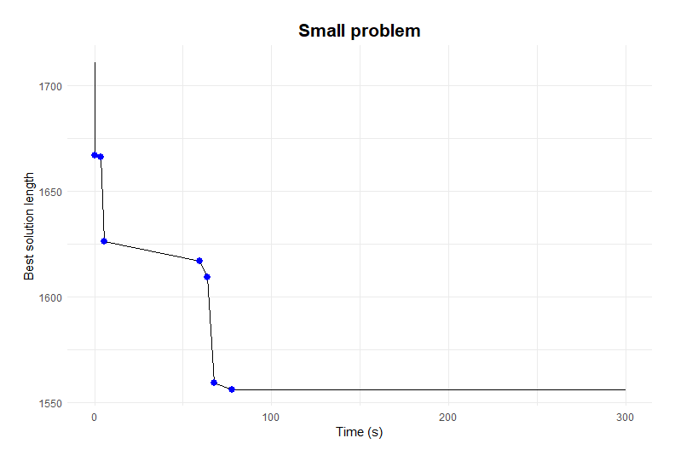

Slide 29
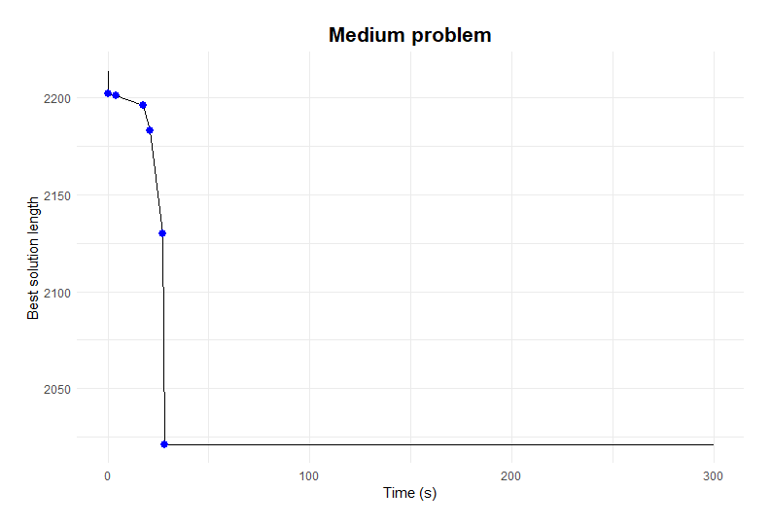

Slide 30
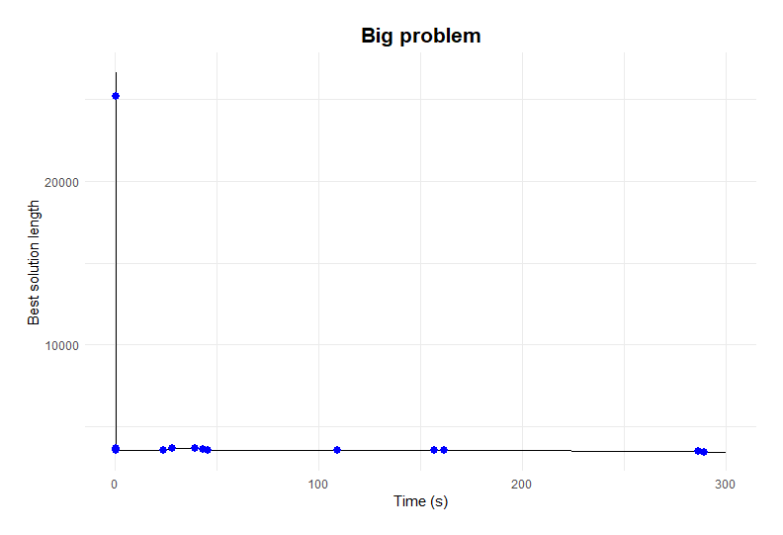

Slide 31
Nasze wyniki w porównaniu z najlepszymi znanymi rozwiązaniami

Slide 32
Bibliografia
[1] https://www.undp.org/sites/g/files/zskgke326/files/migration/mk/transformation.png
[2] https://media.licdn.com/dms/image/D4D22AQHPB41QZ3b0xA/feedshare-shrink_800/0/1684300278082?e=2147483647&v=beta&t=nTMhz3hRYp0bUTt7fKxyJtQtnmNjl-bQxSsBhA58TDU
[3] https://www.sciencedirect.com/science/article/pii/S0096300309001362?via%3Dihub#fig1

Slide 33
Dziękujemy za uwagę

